Slide 1
Coevolution in evolutionary algorithms: part 1 – competitive coevolution
Richard A. Watson
Natural Systems group, ECS, Southampton University, UK

Slide 2
Last time
What was the (narrow) definition of coevolution c.f. Lex?
Some examples of coevolution in nature?

Slide 3
Coevolution basics
evaluation function
f (111100001110001)=4.5
individual
Population 1
fitness
100101001010011
111100001110001
…
010101111010100

Slide 4
Coevolution basics
evaluation function
f (111100001110001, bbbbbaaaaaabbbb)=2.4
individual
individual
Population 1
Population 2
fitness
100101001010011
aaababbabbbbabb
111100001110001
bbbbabababababb
…
…
010101111010100
bbbbbaaaaaabbbb

Slide 5
Coevolution basics
evaluation function
f’ (bbbbbaaaaaabbbb, 111100001110001)=12.3
Population 1
Population 2
100101001010011
aaababbabbbbabb
111100001110001
bbbbabababababb
…
…
010101111010100
bbbbbaaaaaabbbb

Slide 6
Coevolutionary fitness evaluations
e.g.
Asymmetric
  Controllers: e.g. Pursuer/evader
  Instances/classifiers: e.g. lists and sorters
  Symbol production/symbol understanding: e.g. communication
Symmetric
  Two-player games: Chess, drafts, backgammon, tron players, ‘grab the cube’
More than two
  poker

Slide 7
Who plays who
All plays all
  expensive
All plays one
  Random - noisy
  Best of last generation – convergence issues?
Fitness from scores
  Is there one best solution for each population? If the population represents a diverse set of strategies, how should scores against many players be combined?
  Fitness = average score?

Slide 8
The coevolution ideal: why use coevolution?
An implicit fitness function
  Don’t have a fitness function to use for evolution
  E.g. don’t have a good chess player, don’t have a good evaluator for ‘evasion’ or ‘pursuit’
  no need to define fitness function explicitly – one popn defines the ‘problem’ for the other, and fitnesses are determined by the rules of the game (which you can specify)
Gradient engineering – arms race
  Even if you did have a fitness function, would it be one that provided an appropriate gradient?
  E.g. playing against chess master
  Coevolution provides a continuum of opponents that gradually increase in difficulty automatically
Open-ended improvement
  Even if you did have a fitness function and it had a good gradient, would it be open ended?
  E.g. chess again
  Coevolution naturally allows evolution to go to the limits of the game that the representation allows
Ah, blissful naivety

Slide 9
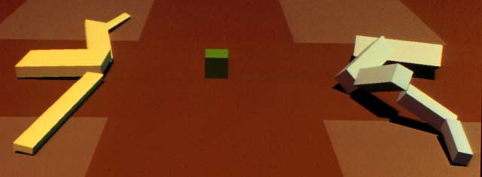
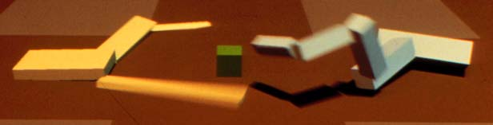
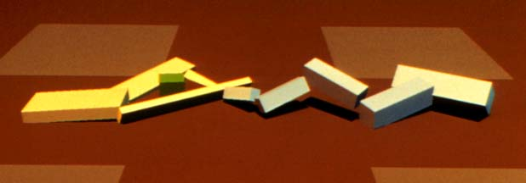
Coevolution examples 1:
Sims creatures
Evolving 3d morphology and behavior by competition
Pop 1: box grabbing creatures
Pop 2: box grabbing creatures

Slide 10
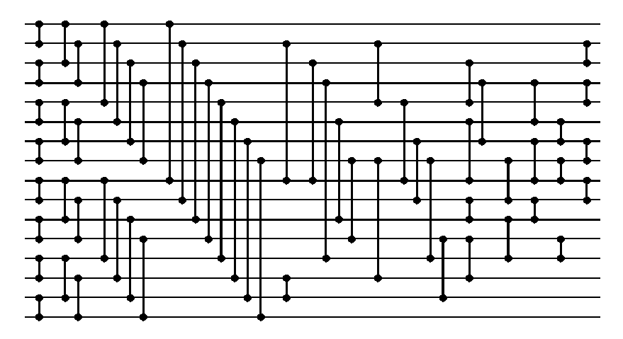
Coevolution examples 2:
Hillis
  Co-evolving parasites improve simulated evolution as an optimization procedure
  Pop 1: input lists to be sorted
  Pop 2: sorting networks
15
78
41
96
12
3
34
39
4
47
81
84
43
54
92
29
3
4
12
15
29
34
39
41
43
47
54
78
81
84
92
96
Inputs
(random order)
Outputs
(sorted order)

Slide 11
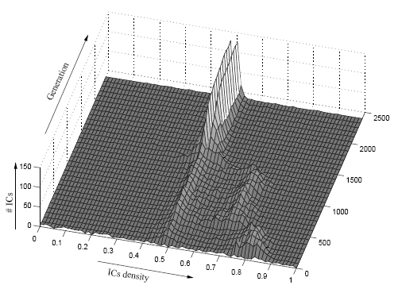
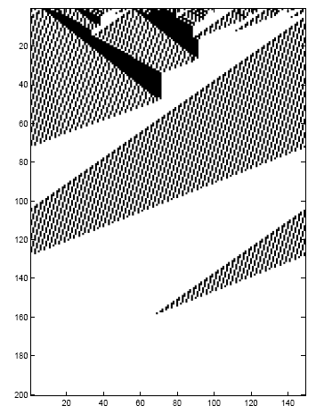
Coevolution examples 3:
Juille: cellular automata density classification rule
  Coevolving the "ideal" trainer: Application to the discovery of cellular automata rules
  Pop1: classifiers. Pop2: initial conditions.
1001001010100110010111101000

Slide 12
What are you trying to optimise anyway?
When coevolution doesn’t optimise what you wanted it to optimise
  Ficici 2004 – coevolution solution concept
  E.g. do you want a player that beats every other possible strategy? Or looses the least
    E.g. noughts and crosses: There are strategies that win more often than ‘optimal’ player against many samples of players (but sometimes loose)
    Is there more than one strategy that never looses?
  Gets the best average score against all possible payers?
  With opponents equally weighted? (assuming a discrete space)
    That might not do well in a tournament that only has good players
‘subjective’ (internal) vs ‘objective’ (external) fitness

Slide 13
Some types of coevolutionary failure
Disengagement/ loss of gradient
  If everyone in population 1 beats everyone in population 2 then everyone in population 1 gets the same (perfect) score.
  And neither population has any gradient for improvement.
Overspecialisation
  If population 1 always starts chess game by moving leftmost pawn, then population 2 will only adapt to this particular opening move
  When playing against a different strategy, population 2 may perform very poorly.
Intransitivity – which way is up?
  Rock>Scissors, Scissors>Paper, Paper>Rock
  May cause cycling/forgetting
Red queen
  Both get OK scores whether you both play well, or both poorly
  “collusion” (to be mediocre together), hence “mediocre stable states”

Slide 14
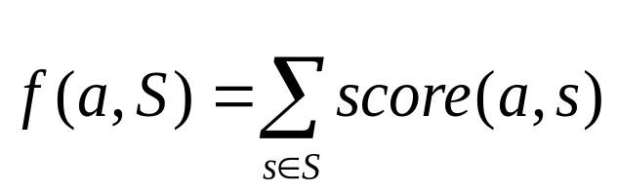
Number games illustrations: disengagement
All individuals are just numbers
‘greater than’ game
where score(a,b)=1 if a>b, 0 otherwise
http://www.demo.cs.brandeis.edu/pr/number_games/Animator1a.html
Smaller sample size leads to disengagement
http://www.demo.cs.brandeis.edu/pr/number_games/Animator1b.html

Slide 15
Over specialisation
Introduce multiple ‘aspects of play’
  e.g. serve vs volley at the net vs base-line strokes
  Different opponents will have a different balance in the aspects of the game that they test
Let two aspects of play be represented by two numbers
Let the importance of each aspect of play be proportional to the difference of abilities in that aspect of play. i.e. the dimension with the biggest difference determines the outcome of the game
http://www.demo.cs.brandeis.edu/pr/number_games/Animator2.html
May not optimise both aspects of play together

Slide 16
Intransitivity
What if the importance of each aspect of play was inversely proportional to the difference in ability in that dimension… i.e. the aspect of play that determines the outcome of the game is the aspect in which the two players are most similar?
Consider
  [1,5] > [4,3] on y
  [4,3] > [3,2] on both
  [3,2] > [1,5] on x
  http://www.demo.cs.
  brandeis.edu/pr/numb
  er_games/Animator3.html
A
B
B’

Slide 17
Ideals revisited
Don’t take coevolution for granted, try something simple first
Beware of disengagement, over-specialisation problems, and intransitive relationships
Be aware of subjective/=objective
Consider multi-dimensional nature of coevolutionary games, cyclic superiority
Lots of different things can cause failure, forgetting and cycling, mediocre results
The coevolution ideals
  An implicit fitness function – still needs careful design
  Gradient engineering – arms race can be easily broken
  Open-ended improvement – never-ending tail chasing!

Slide 18
See also
M. Ebner, R. A. Watson, J. Alexander. Co-evolutionary dynamics on a deformable landscape
Movie

Slide 19
Summary
Examples of (artificial) coevolution
Potential advantages of coevolution
Potential problems of coevolution

